Slide 1

BEAST CROSS
~ Team-11
-----------------------------------------
19H51A0597 – Avinash Sharma
19H51A05A2 – Iffat Maria
19H51A05A6 – K Rohan
19H51A05C1 – Y Archana
19H51A05J2 – V Bhuvana
------------------------------------------

Slide 2

Abstract:
Railway is one of the most convenient modes of passenger transport. Animals on train tracks are dangerous for both animals and the train as well.
We propose a method for reducing wildlife losses on railways by alerting the train driver to slow down or stop the train, particularly in areas of high strike risk.
We use Raspberry pi which plays vital role to coordinate the devices used in the system. The python script defines two regions in the image captured by the camera, an "inside“ region(between tracks) and an "outside" region(safe region where the animals remain unharmed).If the animals are detected for at-least 10 consecutive frames, then a text message is sent.

Slide 3
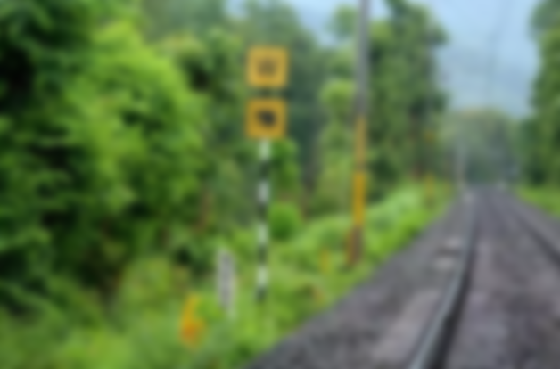
Introduction:
Railway is one of the most convenient modes of passenger transport. Animals on train tracks are dangerous for both animals and the train as well.
It is known that due to advancement in technology, many tracks were converted from narrow gauge(from 1 ft 115⁄8 in to 3 ft 6 in) to standard gauge(4 ft 81⁄2 in), allowing high speed trains to run. The steep embankments alongside these tracks make it even more difficult for the bulky and slow-moving animals to escape when a train approaches and hence accidents occur.
We propose a method for reducing wildlife losses on railways by alerting the train driver with an alert message, relayed in the form of audio and also automatically slow down or stop the train, particularly in areas of high strike risk.

Slide 4
Problem statement:
Railway lines and other linear infrastructure projects which run through the forests for thousands of kilometers affect wildlife corridors. This causes the fragmentation of their habitat.
Animals have a natural tendency to cross the tracks to reach nearby water bodies, or in search of food, and sometimes end up getting trapped.
We propose a method for reducing wildlife losses on railways. We use Raspberry pi 4, which plays a vital role to coordinate the devices used in the system. The Computer Vision defines a raw overlay of a frame that tells what kind of object is detected, any kind of moving object is clearly identified and recognized. If the animals are detected for at-least 10 consecutive frames, then the alert message is announced.
The alert message is announced via speakers, automatically lowering the tarin lever and slows down the train.

Slide 5
Aim of the Project:
Our project mainly focusses on wildlife conservation , the project methodology favors the fact that wildlife losses on the train tracks are due to the negligence of the need to maintain a proper system.
Animals on the track can be dangerous to both, the train and the animals too, since the trains on the tracks move at a high speed, applying a sudden break would cause an excessive opposite force that may lead to disturbance in the bogies behind, and in worst case, the train to get off-track too.
Henceforth we have put forward this idea of wildlife conservation to reduce animal deaths while crossing the tracks and hereby reducing damage to both train and the animal on the track.

Slide 6
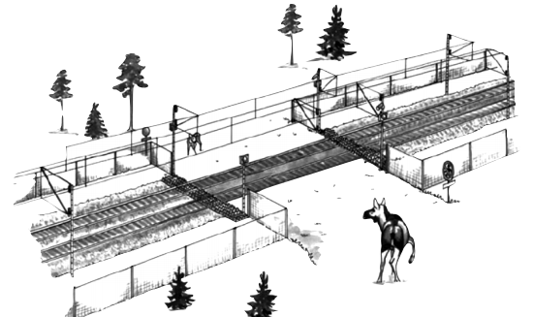
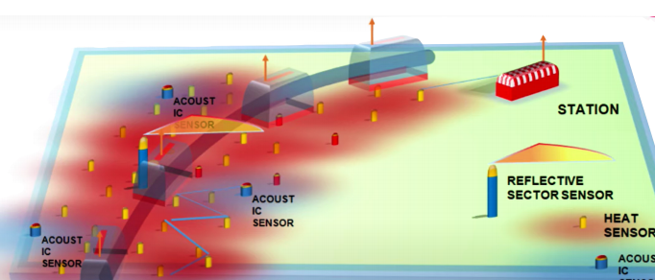
Literature review:
Many people came up with different ideas for this cause. The following is a brief list of the existing ideas:
Wildlife exclusion fencing:
The Swedish Railways have employed a system of including wildlife exclusion fencing alongside the railway track to avoid wildlife-train collisions
However, this project is not possible in India, as the wild life in our country is more diverse and the weather conditions tend to wear down the fencing.
The warning system:
The main focus of this project is to reduce elephant deaths on the tracks.
The warning system comprises four sensors that detect feet vibration, infrared rays coming from the approaching animals, a laser detector and a camera to recognize the elephants.
However, Multiple layers of sensors need to placed as a network to ensure the accurate location of animals.

Slide 7
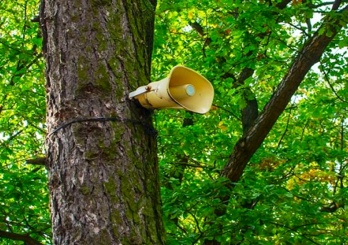
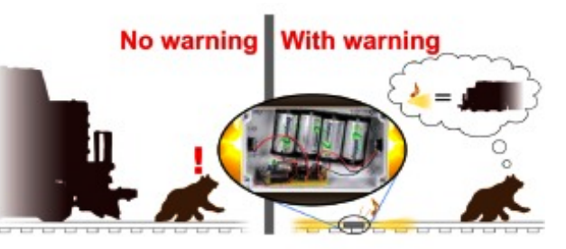
Plan Bee:
The Northeast Frontier Railway (NFR) came with an innovative ‘ plan bee’ to prevent elephant deaths on the tracks. And the initiative involves keeping them away from the tracks by scaring them.
The underlying problem is that when the warning sound is not followed by a real threat and is merely a bluff without consequence, animals will soon habituate and learn to ignore the signal.
This system works only for elephants.
Warning signals triggered by trains:
This method reduces losses of wildlife on railways by providing animals with warning signals that are triggered by approaching trains, particularly in areas of high strike risk.
The designed model detected passing trains with vibration and magnetic sensors and relayed the signals to warning devices.
However, this model works on batteries, which need to be replaced frequently.
If there is a false alarm, animals get used to it, thereby making it ineffective.

Slide 8
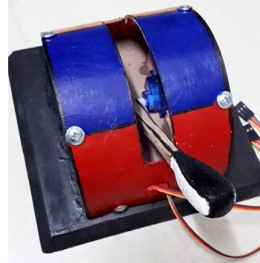
Proposed Methodology:
Our design includes mainly two steps: object detection and movement of the lever, i.e. lowering the lever as the object gets closer.
Here we use Raspberry Pi 3 as an intermediate that connects the real world to the computing side of our model.
The camera module is placed on the train Pilot (in front of the train) and identifies any animal on the tracks.
The ultrasonic sensor detects any obstacle on the tracks and the camera module identifies the object that is on the tracks.
It in turn relays an audio message to the train driver, announcing the obstacle on the tracks in the form of a horn audio clip. The servo motors, control the movement of the train lever as the object distance with the train decreases.

Slide 9
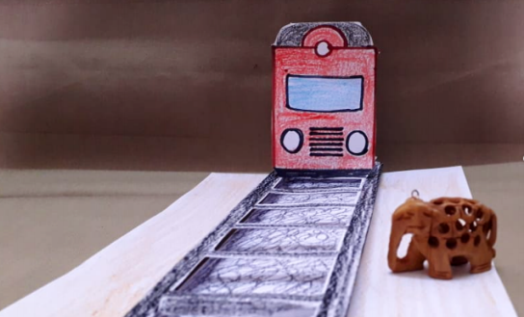
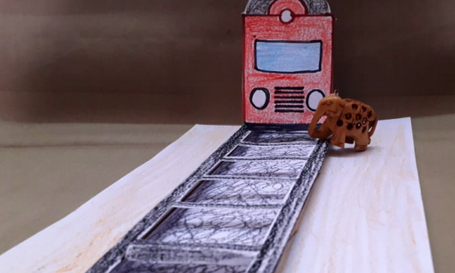
Conceptual Design:
Ultrasonic sensor
&
Camera module

Slide 10
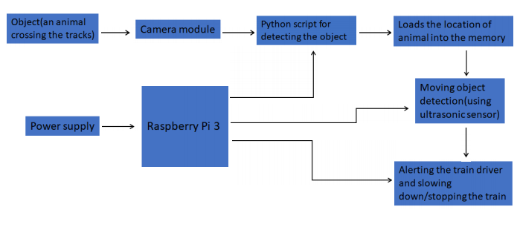
Block diagram:

Slide 11

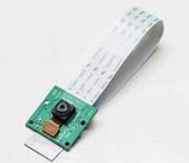



Requirement Analysis:
Hardware Components
Software Used
Raspberry Pi 3 B+
Camera module
Ultrasonic sensor
Speaker
Servo motor SG-90
Jumper Wires
Python
OpenCV2
TensorFlow

Slide 12
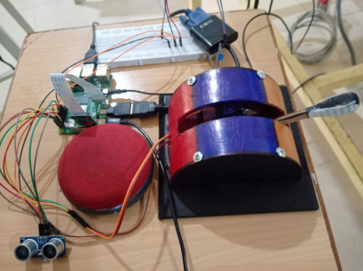
Implementation:
Automation of the brakes for the train is completely feasible.
Less manpower is required compared to other models.
Not only animals, but any kind of obstacle can be detected easily and be brought to the notice of the train driver immediately.
Our prototype can be used mostly on Trains as it's sole purpose is to alert the driver of any dangers on the tracks and automatically control the lever to stop the train.

Slide 13
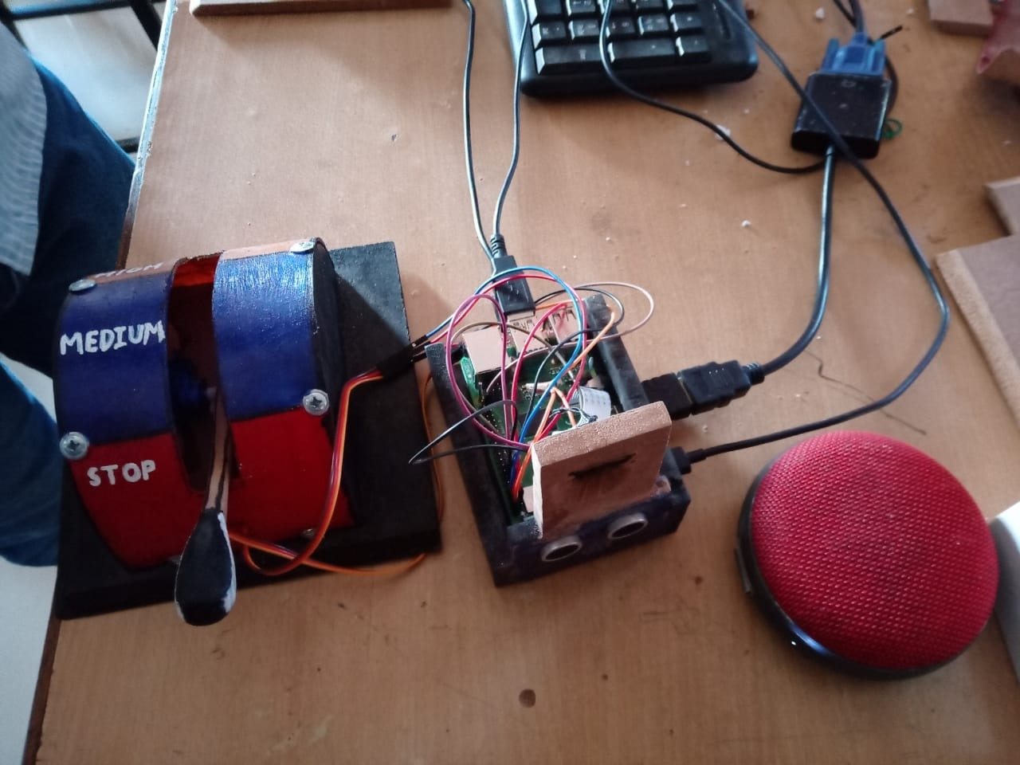
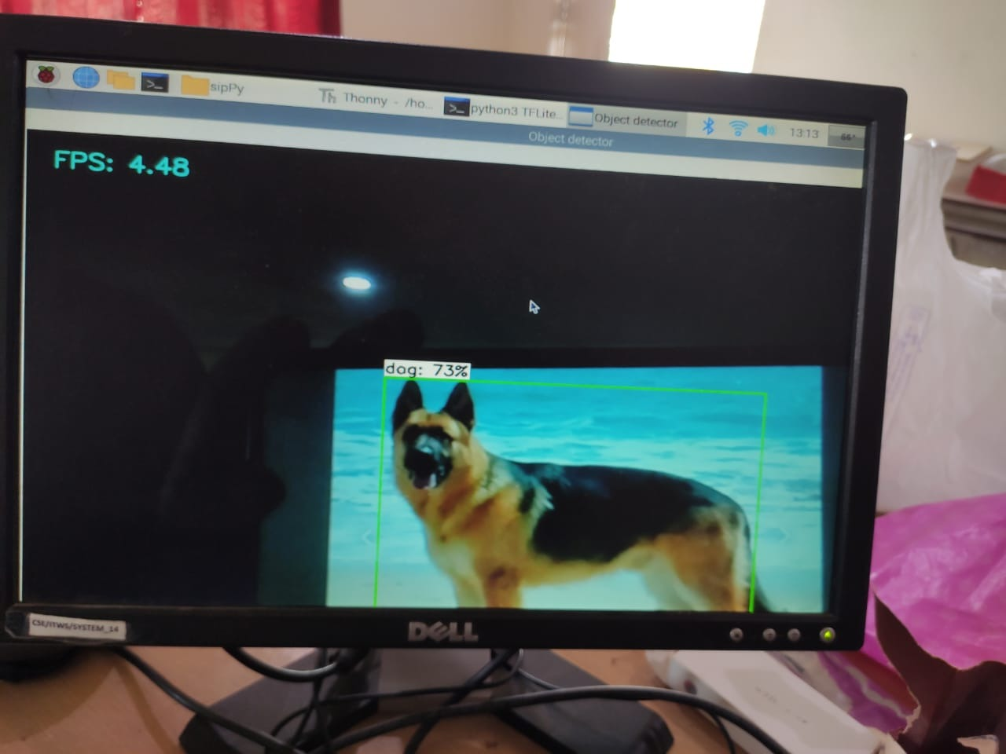
Results & Discussions:

Slide 14
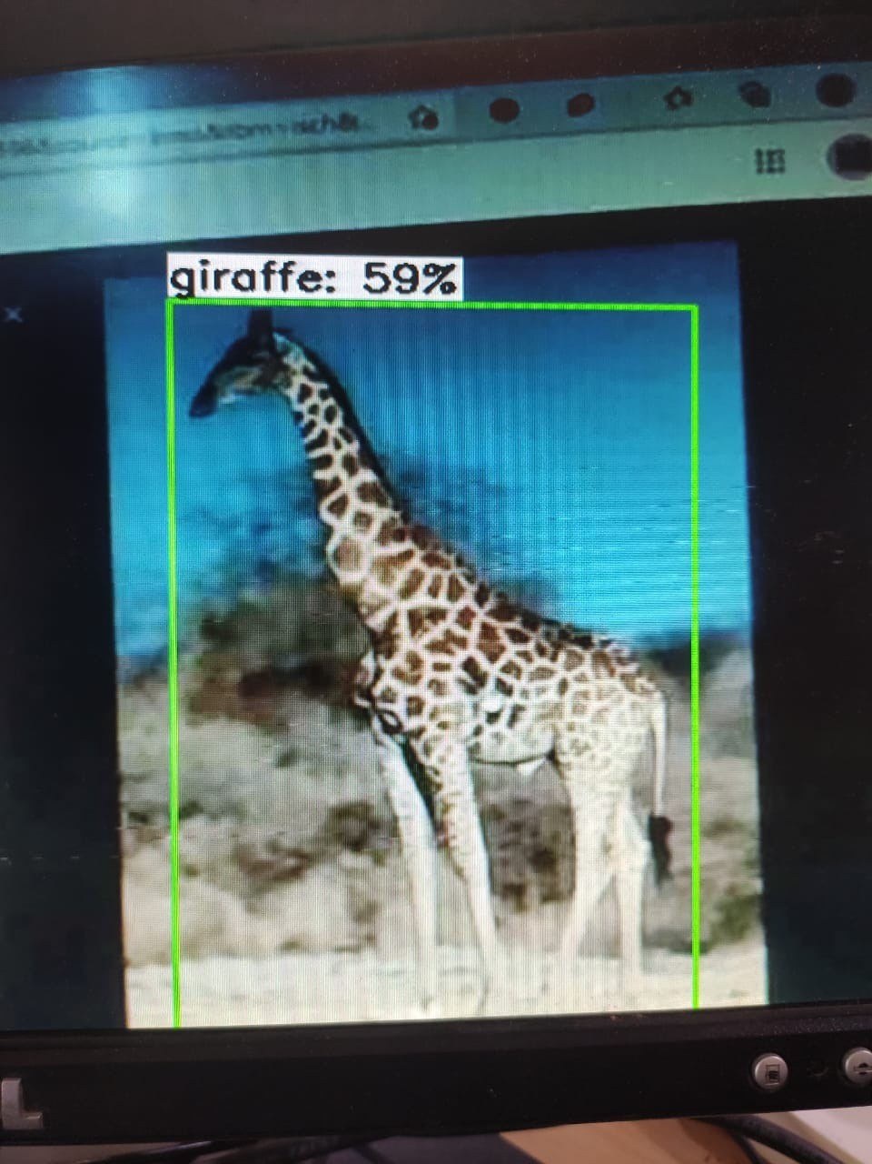
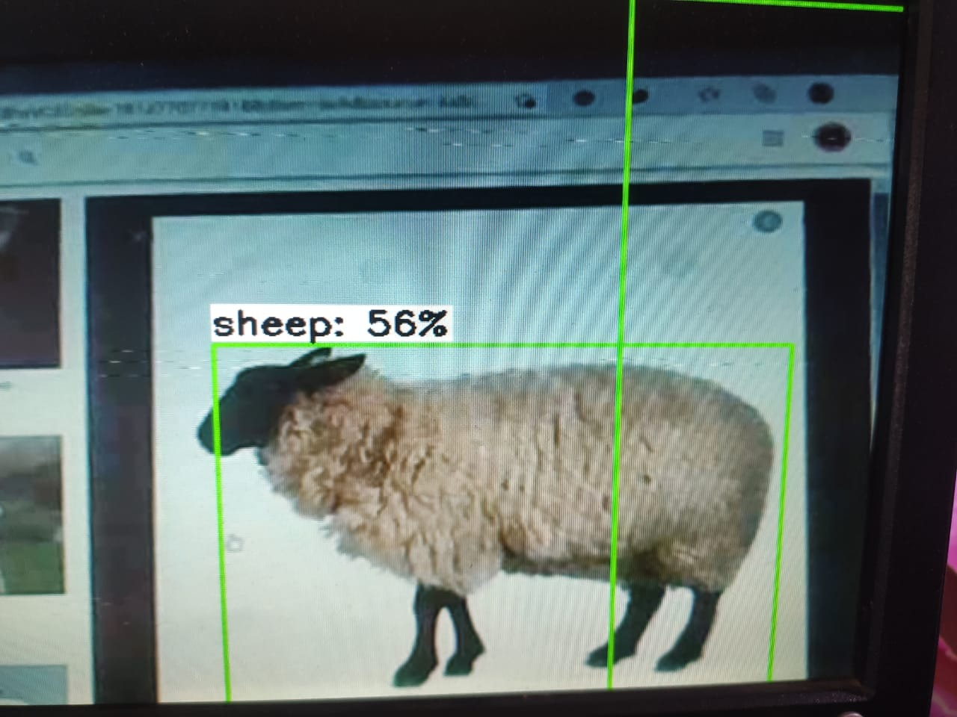
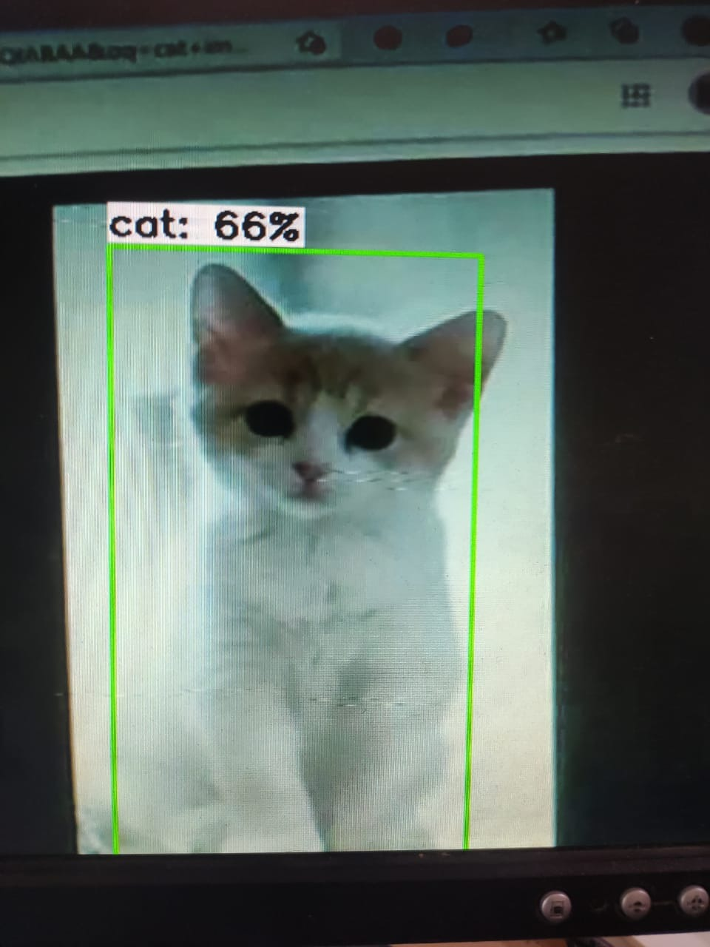
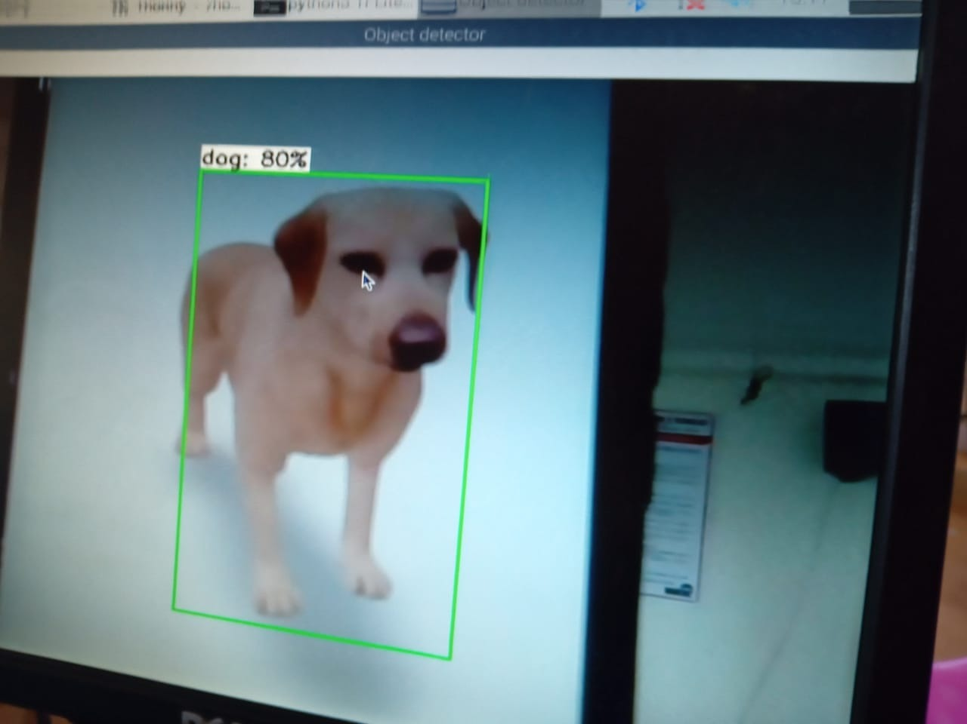

Slide 15
Conclusion:
Our prototype, "Beast cross" helps avert dangerous train accidents and helps save the lives of wild-animals, whose habitat is perforated by railway tracks.
It alerts the driver of the train and immediately slows down and eventually stops the train, it is cost efficient compared to the existing solutions to curb this problem and also works pretty effectively.

Slide 16
References:
https://www.newindianexpress.com/cities/bhubaneswar/2021/jan/03/iit-profs-answer-tojumbodeaths-in-traincollision
https://www.electronicshub.org/raspberry-pi-servo-motor-interface-tutorial/
https://www.scoopwhoop.com/inothernews/elephants-killed-on-railway-tracks/
https://www.researchgate.net/publication/319893322_Wildlife_Deterrent_Methods_for_RailwaysAn_Experimental_Study
https://www.researchgate.net/publication/286712967_Wildlife_conservation_and_rail_track_monitoring_using_wireless_sensor_networks

